Slide 1
2018-2학기 오픈SW플랫폼
2018-10-17
Firebase Android Codelab (이어서)

Slide 2
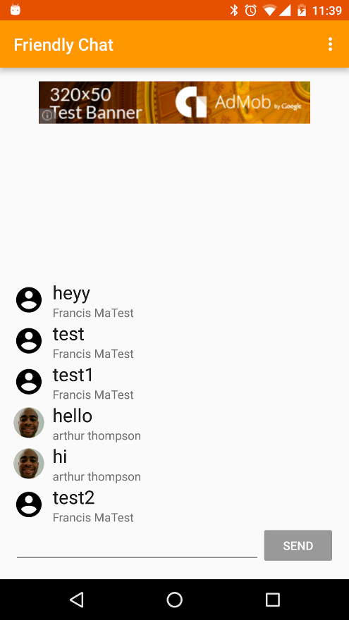
Android Codelab 실습
Firebase를 이용한 안드로이드용 채팅 앱 만들기
(https://codelabs.developers.google.com/codelabs/firebase-android/)
오늘의 실습 내용
사용자 승인
Firebase Realtime Database를 이용한 데이터 동기화
Firebase Notifications를 이용한 알림메시지 받기
Firebase Remote Config를 이용한 앱 설정
Google Analytics for Firebase를 이용한 사용량 추적
Firebase Invite를 이용한 초청메시지 보내기
AdMob를 사용하여 광고 띄우기
Firebase Crash Reporting을 이용하여 크래쉬 보고하기
Firebase Test Lab을 이용하여 앱 테스트하기

Slide 3
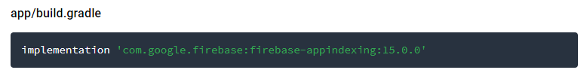
Android Codelab 실습
8. 메시지 인덱싱하기
App indexing dependency 추가하기
아래의 코드가 app/build.gradle 파일에 있는 지 확인
Notes:
Store and sync data between users and devices in realtime using a cloud-hosted, NoSQL database. Updated data syncs across connected devices in milliseconds, and data remains available if your app goes offline, providing a great user experience regardless of network connectivity.

Slide 4
Android Codelab 실습
8. 메시지 인덱싱하기
Intent filter 추가
아래의 코드 중 큰 글씨만 AndroidManifest.xml 파일에 추가
<activity android:name="com.google.firebase.codelab.friendlychat.MainActivity">
<intent-filter>
<action android:name="android.intent.action.MAIN"/>
<category android:name="android.intent.category.LAUNCHER"/>
</intent-filter>
<intent-filter>
<action android:name="android.intent.action.VIEW"/>
<category android:name="android.intent.category.DEFAULT"/>
<category android:name="android.intent.category.BROWSABLE"/>
<data android:host="friendlychat.firebase.google.com" android:scheme="http" android:pathPrefix="/message" />
</intent-filter>
</activity>
Notes:
Store and sync data between users and devices in realtime using a cloud-hosted, NoSQL database. Updated data syncs across connected devices in milliseconds, and data remains available if your app goes offline, providing a great user experience regardless of network connectivity.

Slide 5
Android Codelab 실습
8. 메시지 인덱싱하기
개인 기기에서 메시지 인덱싱 가능하게 하기
아래 코드를 MainAcvitity.java에 추가
private Indexable getMessageIndexable(FriendlyMessage friendlyMessage) {
PersonBuilder sender = Indexables.personBuilder()
.setIsSelf(mUsername.equals(friendlyMessage.getName()))
.setName(friendlyMessage.getName())
.setUrl(MESSAGE_URL.concat(friendlyMessage.getId() + "/sender"));
PersonBuilder recipient = Indexables.personBuilder()
.setName(mUsername)
.setUrl(MESSAGE_URL.concat(friendlyMessage.getId() + "/recipient"));
Indexable messageToIndex = Indexables.messageBuilder()
.setName(friendlyMessage.getText())
.setUrl(MESSAGE_URL.concat(friendlyMessage.getId()))
.setSender(sender)
.setRecipient(recipient)
.build();
return messageToIndex;
}
Notes:
Store and sync data between users and devices in realtime using a cloud-hosted, NoSQL database. Updated data syncs across connected devices in milliseconds, and data remains available if your app goes offline, providing a great user experience regardless of network connectivity.

Slide 6
Android Codelab 실습
8. 메시지 인덱싱하기
새로운 메시지가 올 때마다 메시지 인덱스 업데이트
MainActivity.java에서 onBindViewHolder()안 제일 끝에 큰 글씨 추가
@Override protected void onBindViewHolder(final MessageViewHolder viewHolder, FriendlyMessage friendlyMessage, int position) {
...
if (friendlyMessage.getText() != null) {
// write this message to the on-device index
FirebaseAppIndex.getInstance().update(getMessageIndexable(friendlyMessage));
}
}
Notes:
Store and sync data between users and devices in realtime using a cloud-hosted, NoSQL database. Updated data syncs across connected devices in milliseconds, and data remains available if your app goes offline, providing a great user experience regardless of network connectivity.

Slide 7
Android Codelab 실습
8. 메시지 인덱싱하기
사용자 액션 기록(로깅)하기
MainActivity.java에서 onBindViewHolder()안 제일 끝에 큰 글씨 추가
Notes:
Store and sync data between users and devices in realtime using a cloud-hosted, NoSQL database. Updated data syncs across connected devices in milliseconds, and data remains available if your app goes offline, providing a great user experience regardless of network connectivity.

Slide 8
Android Codelab 실습
8. 메시지 인덱싱하기
사용자 액션 기록(로깅)하기
MainActivity.java에 다음 함수 추가
...
@Override protected void onBindViewHolder(final MessageViewHolder viewHolder, FriendlyMessage friendlyMessage, int position) {
...
if (friendlyMessage.getText() != null) {
// write this message to the on-device index
FirebaseAppIndex.getInstance().update(getMessageIndexable(friendlyMessage));
}
// log a view action on it
FirebaseUserActions.getInstance().end(getMessageViewAction(friendlyMessage));
}
Notes:
Store and sync data between users and devices in realtime using a cloud-hosted, NoSQL database. Updated data syncs across connected devices in milliseconds, and data remains available if your app goes offline, providing a great user experience regardless of network connectivity.

Slide 9
Android Codelab 실습
8. 메시지 인덱싱하기
테스트해보기
FriendlyChat app 열고 “Hi world!”라고 메시지 보내기
Google app, In App(개인) tab에서 “Hi world!” 검색해보기
검색결과 확인
검색결과에서 “앱으로 이동＂을 눌렀을 때 이동하는 지 확인하기
Notes:
Store and sync data between users and devices in realtime using a cloud-hosted, NoSQL database. Updated data syncs across connected devices in milliseconds, and data remains available if your app goes offline, providing a great user experience regardless of network connectivity.

Slide 10
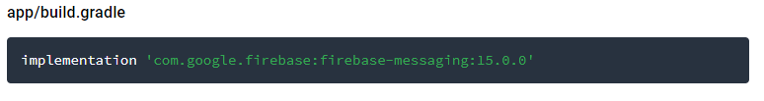
Android Codelab 실습
9. 알림메시지 (Notification) 보내기
Firebase Cloud Messaging (FCM) dependency 추가
App/build.gradle에 아래 코드가 있는지 확인
Notes:
Store and sync data between users and devices in realtime using a cloud-hosted, NoSQL database. Updated data syncs across connected devices in milliseconds, and data remains available if your app goes offline, providing a great user experience regardless of network connectivity.

Slide 11
Android Codelab 실습
9. 알림메시지 (Notification) 보내기
FCM 서비스 추가
메시지 핸들링을 위해 MyFirebaseMessagingService.java에서 MyFirebaseMessgingService 클래스를 아래의 코드로 대체
public class MyFirebaseMessagingService extends FirebaseMessagingService {
private static final String TAG = "MyFMService";
@Override public void onMessageReceived(RemoteMessage remoteMessage) {
// Handle data payload of FCM messages.
Log.d(TAG, "FCM Message Id: " + remoteMessage.getMessageId());
Log.d(TAG, "FCM Notification Message: " + remoteMessage.getNotification());
Log.d(TAG, "FCM Data Message: " + remoteMessage.getData());
}
}
Notes:
Store and sync data between users and devices in realtime using a cloud-hosted, NoSQL database. Updated data syncs across connected devices in milliseconds, and data remains available if your app goes offline, providing a great user experience regardless of network connectivity.

Slide 12
Android Codelab 실습
9. 알림메시지 (Notification) 보내기
FCM 서비스 추가
MyFirebaseInstanceIdService.java에서 onTokenRefresh()를 아래의 코드로 업데이트
public class MyFirebaseInstanceIdService extends FirebaseInstanceIdService {
private static final String TAG = "MyFirebaseIIDService";
private static final String FRIENDLY_ENGAGE_TOPIC = "friendly_engage";
/** * The Application's current Instance ID token is no longer valid * and thus a new one must be requested. */
@Override public void onTokenRefresh() {
// If you need to handle the generation of a token, initially or
// after a refresh this is where you should do that.
String token = FirebaseInstanceId.getInstance().getToken();
Log.d(TAG, "FCM Token: " + token);
// Once a token is generated, we subscribe to topic.
FirebaseMessaging.getInstance().subscribeToTopic(FRIENDLY_ENGAGE_TOPIC);
}
}
Notes:
Store and sync data between users and devices in realtime using a cloud-hosted, NoSQL database. Updated data syncs across connected devices in milliseconds, and data remains available if your app goes offline, providing a great user experience regardless of network connectivity.

Slide 13
Android Codelab 실습
9. 알림메시지 (Notification) 보내기
FCM 서비스 추가
AndroidManifest.xml파일에 MyFirebaseMessagingService와 MyFirebaseInstanceIDService를 application 안에 추가
<service
android:name=".MyFirebaseMessagingService" android:exported="false">
<intent-filter>
<action android:name="com.google.firebase.MESSAGING_EVENT" />
</intent-filter>
</service>
<service
android:name=".MyFirebaseInstanceIdService" android:exported="false">
<intent-filter>
<action android:name="com.google.firebase.INSTANCE_ID_EVENT" />
</intent-filter>
</service>
Notes:
Store and sync data between users and devices in realtime using a cloud-hosted, NoSQL database. Updated data syncs across connected devices in milliseconds, and data remains available if your app goes offline, providing a great user experience regardless of network connectivity.

Slide 14
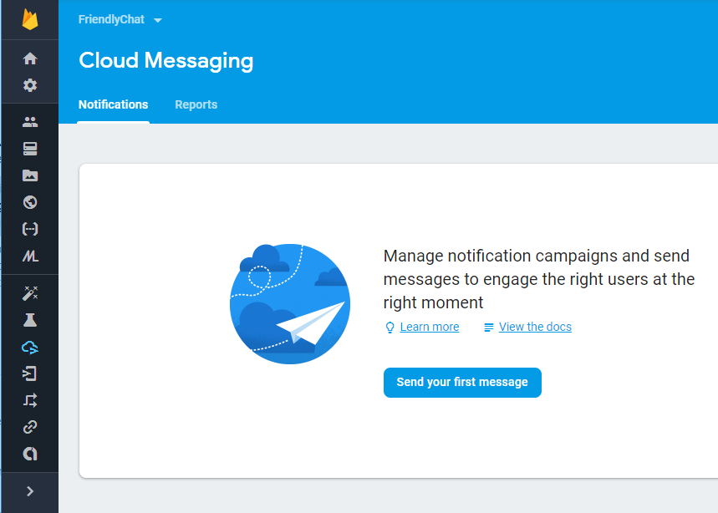
Android Codelab 실습
9. 알림메시지 (Notification) 보내기
테스트하기
앱 실행
기기에서 홈 버튼 누르기
Firebase 콘솔의 Grow 섹션에서 Cloud Messaging을 선택
Send your first message 클릭
Notes:
Store and sync data between users and devices in realtime using a cloud-hosted, NoSQL database. Updated data syncs across connected devices in milliseconds, and data remains available if your app goes offline, providing a great user experience regardless of network connectivity.

Slide 15
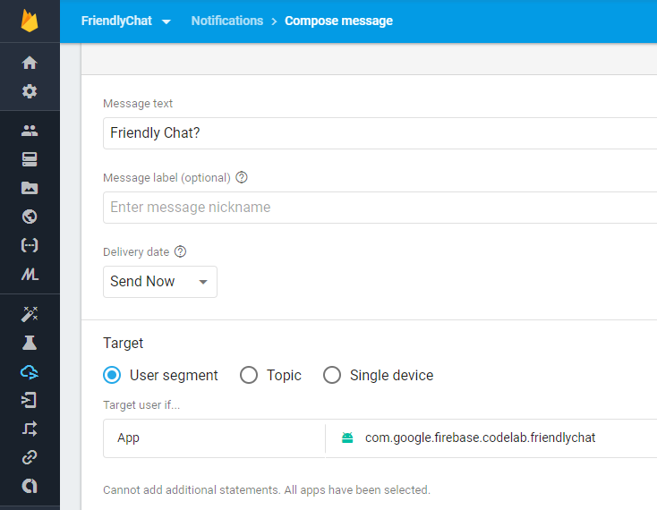
Android Codelab 실습
9. 알림메시지 (Notification) 보내기
테스트하기
메시지란에 “Friendly Chat?”입력
앱 타겟으로 com.google.firebase.codelab.friendlychat 지정
하단에 Send Message 클릭
기기로 알림메시지를 확인
Notes:
Store and sync data between users and devices in realtime using a cloud-hosted, NoSQL database. Updated data syncs across connected devices in milliseconds, and data remains available if your app goes offline, providing a great user experience regardless of network connectivity.

Slide 16
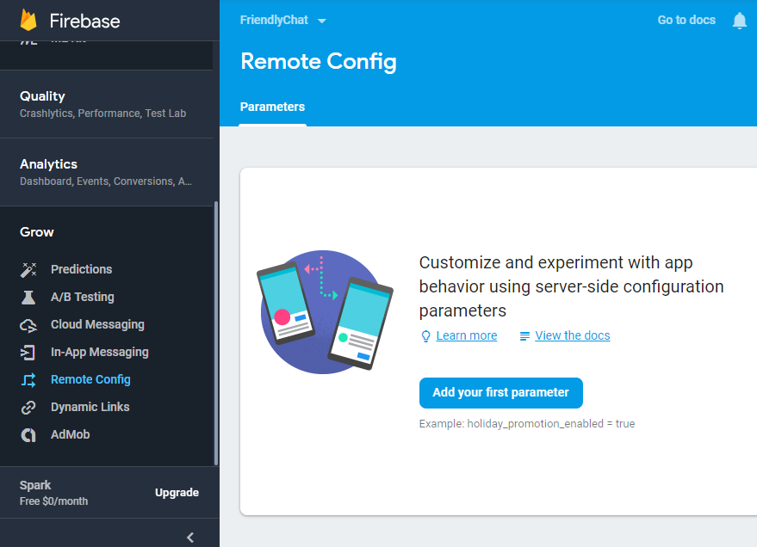
Android Codelab 실습
10. 메시지 최대 길이 원격 설정
Firebase 콘솔에서 Config Rule 선택
Add your first parameter 클릭
Notes:
Store and sync data between users and devices in realtime using a cloud-hosted, NoSQL database. Updated data syncs across connected devices in milliseconds, and data remains available if your app goes offline, providing a great user experience regardless of network connectivity.

Slide 17
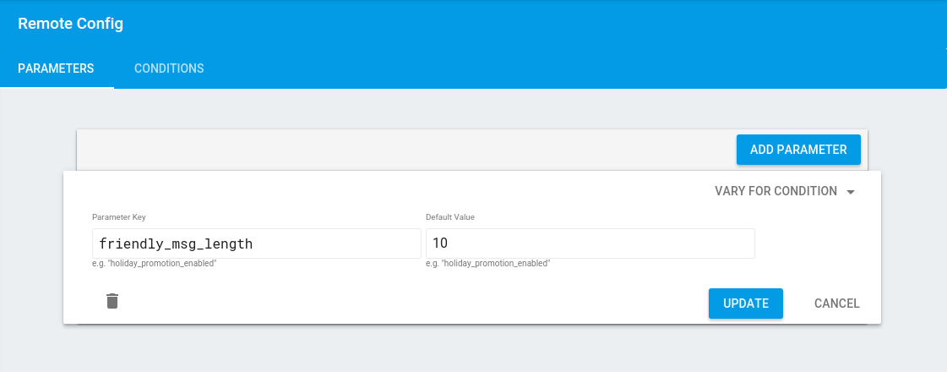
Android Codelab 실습
10. 메시지 최대 길이 원격 설정
Parameter key에 “friendly_msg_length”를 입력
Parameter value에 “10”을 입력
하단에 있는 업데이트 버튼 클릭
상단에 있는 publish changes 클릭
Notes:
Store and sync data between users and devices in realtime using a cloud-hosted, NoSQL database. Updated data syncs across connected devices in milliseconds, and data remains available if your app goes offline, providing a great user experience regardless of network connectivity.

Slide 18

Android Codelab 실습
10. 메시지 최대 길이 원격 설정
app/build.gradle 파일에 다음 코드가 있는 지 확인
MainActivity.java에 아래 변수를 추가
// Firebase instance variables
private FirebaseRemoteConfig mFirebaseRemoteConfig;
Notes:
Store and sync data between users and devices in realtime using a cloud-hosted, NoSQL database. Updated data syncs across connected devices in milliseconds, and data remains available if your app goes offline, providing a great user experience regardless of network connectivity.

Slide 19
Android Codelab 실습
10. 메시지 최대 길이 원격 설정
MainActivity.java의 onCreate()함수에 아래 코드를 Firebase Realtime Database 초기화 한 곳 위에 추가
// Initialize Firebase Remote Config.
mFirebaseRemoteConfig = FirebaseRemoteConfig.getInstance();
// Define Firebase Remote Config Settings.
FirebaseRemoteConfigSettings firebaseRemoteConfigSettings = new FirebaseRemoteConfigSettings.Builder().setDeveloperModeEnabled(true).build();
// Define default config values. Defaults are used when fetched config values are not
// available. Eg: if an error occurred fetching values from the server.
Map<String, Object> defaultConfigMap = new HashMap<>();
defaultConfigMap.put("friendly_msg_length", 10L);
// Apply config settings and default values.
mFirebaseRemoteConfig.setConfigSettings(firebaseRemoteConfigSettings);
mFirebaseRemoteConfig.setDefaults(defaultConfigMap);
// Fetch remote config.
fetchConfig();
Notes:
Store and sync data between users and devices in realtime using a cloud-hosted, NoSQL database. Updated data syncs across connected devices in milliseconds, and data remains available if your app goes offline, providing a great user experience regardless of network connectivity.

Slide 20
Android Codelab 실습
10. 메시지 최대 길이 원격 설정
MainActivity.java에 fetchConfig() 함수 추가
// Fetch the config to determine the allowed length of messages.
public void fetchConfig() {
long cacheExpiration = 3600;
// 1 hour in seconds
// If developer mode is enabled reduce cacheExpiration to 0 so that
// each fetch goes to the server. This should not be used in release
// builds.
if (mFirebaseRemoteConfig.getInfo().getConfigSettings().isDeveloperModeEnabled()) {
cacheExpiration = 0;
}
mFirebaseRemoteConfig.fetch(cacheExpiration).addOnSuccessListener(new OnSuccessListener<Void>() {
@Override public void onSuccess(Void aVoid) {
// Make the fetched config available via
// FirebaseRemoteConfig get<type> calls.
mFirebaseRemoteConfig.activateFetched();
applyRetrievedLengthLimit();
}
}).addOnFailureListener(new OnFailureListener() {
@Override public void onFailure(@NonNull Exception e) {
// There has been an error fetching the config
Log.w(TAG, "Error fetching config: " + e.getMessage());
applyRetrievedLengthLimit();
}
});
}
Notes:
Store and sync data between users and devices in realtime using a cloud-hosted, NoSQL database. Updated data syncs across connected devices in milliseconds, and data remains available if your app goes offline, providing a great user experience regardless of network connectivity.

Slide 21
Android Codelab 실습
10. 메시지 최대 길이 원격 설정
MainActivity.java에 applyRetrievedLengthLimit() 추가
/**
*Apply retrieved length limit to edit text field.
* This result may be fresh from the server or it may be from cached
* values. */
private void applyRetrievedLengthLimit() {
Long friendly_msg_length = mFirebaseRemoteConfig.getLong("friendly_msg_length");
mMessageEditText.setFilters(new InputFilter[]{new InputFilter.LengthFilter(friendly_msg_length.intValue())});
Log.d(TAG, "FML is: " + friendly_msg_length);
}
Notes:
Store and sync data between users and devices in realtime using a cloud-hosted, NoSQL database. Updated data syncs across connected devices in milliseconds, and data remains available if your app goes offline, providing a great user experience regardless of network connectivity.

Slide 22
Android Codelab 실습
10. 메시지 최대 길이 원격 설정
MainActivity.java에 applyRetrievedLengthLimit() 추가
/**
*Apply retrieved length limit to edit text field.
* This result may be fresh from the server or it may be from cached
* values. */
private void applyRetrievedLengthLimit() {
Long friendly_msg_length = mFirebaseRemoteConfig.getLong("friendly_msg_length");
mMessageEditText.setFilters(new InputFilter[]{new InputFilter.LengthFilter(friendly_msg_length.intValue())});
Log.d(TAG, "FML is: " + friendly_msg_length);
}
Notes:
Store and sync data between users and devices in realtime using a cloud-hosted, NoSQL database. Updated data syncs across connected devices in milliseconds, and data remains available if your app goes offline, providing a great user experience regardless of network connectivity.

Slide 23
Android Codelab 실습
10. 메시지 최대 길이 원격 설정
MainActivity.java에 onOptionsItemSelected() 를 아래 코드로 대체
@Override public boolean onOptionsItemSelected(MenuItem item) {
switch (item.getItemId()) {
case R.id.fresh_config_menu:
fetchConfig();
return true;
case R.id.sign_out_menu:
mFirebaseAuth.signOut();
mUsername = ANONYMOUS;
startActivity(new Intent(this, SignInActivity.class));
return true;
default:
return super.onOptionsItemSelected(item);
}
}
Notes:
Store and sync data between users and devices in realtime using a cloud-hosted, NoSQL database. Updated data syncs across connected devices in milliseconds, and data remains available if your app goes offline, providing a great user experience regardless of network connectivity.

Slide 24
Android Codelab 실습
10. 메시지 최대 길이 원격 설정
테스트하기
Gradle 동기화하기
앱 실행
메시지 길이 제한이 10으로 설정되어 있는지 확인
Firebase 콘솔에서 길이를 10에서 15로 바꾸기
앱의 오른쪽 상단 메뉴에서 fresh config를 클릭
글자길이 제한이 15로 바뀌었는지 확인
Notes:
Store and sync data between users and devices in realtime using a cloud-hosted, NoSQL database. Updated data syncs across connected devices in milliseconds, and data remains available if your app goes offline, providing a great user experience regardless of network connectivity.

Slide 25

Android Codelab 실습
11. 초대메시지 보내기
AppInvite dependency 추가
아래 코드가 app/build.gradle에 있는 지 확인
없으면 추가
implementation 'com.google.android.gms:play-services-appinvite:15.0.0'
Notes:
Store and sync data between users and devices in realtime using a cloud-hosted, NoSQL database. Updated data syncs across connected devices in milliseconds, and data remains available if your app goes offline, providing a great user experience regardless of network connectivity.

Slide 26
Android Codelab 실습
11. 초대메시지 보내기
MainActivity.java에 sendInvitation() 추가
private void sendInvitation() {
Intent intent = new AppInviteInvitation.IntentBuilder(getString(R.string.invitation_title)) .setMessage(getString(R.string.invitation_message))
.setCallToActionText(getString(R.string.invitation_cta))
.build();
startActivityForResult(intent, REQUEST_INVITE);
}
Notes:
Store and sync data between users and devices in realtime using a cloud-hosted, NoSQL database. Updated data syncs across connected devices in milliseconds, and data remains available if your app goes offline, providing a great user experience regardless of network connectivity.

Slide 27
Android Codelab 실습
11. 초대메시지 보내기
MainActivity.java의 onActivityResult()안에 아래 큰 글씨 조건문 추가
@Override protected void onActivityResult(int requestCode, int resultCode, Intent data) {
…
if (requestCode == REQUEST_IMAGE) {
…
} else if (requestCode == REQUEST_INVITE) {
if (resultCode == RESULT_OK) {
// Check how many invitations were sent and log.
String[] ids = AppInviteInvitation.getInvitationIds(resultCode, data);
Log.d(TAG, "Invitations sent: " + ids.length);
} else {
// Sending failed or it was canceled, show failure message to the user
Log.d(TAG, "Failed to send invitation.");
}
}
}
Notes:
Store and sync data between users and devices in realtime using a cloud-hosted, NoSQL database. Updated data syncs across connected devices in milliseconds, and data remains available if your app goes offline, providing a great user experience regardless of network connectivity.

Slide 28
Android Codelab 실습
11. 초대메시지 보내기
MainActivity.java의 onOptionsItemSelected()에 아래 큰 글씨 코드 추가
@Override public boolean onOptionsItemSelected(MenuItem item) {
switch (item.getItemId()) {
case R.id.invite_menu:
sendInvitation();
return true;
case R.id.fresh_config_menu:
…
}
}
Notes:
Store and sync data between users and devices in realtime using a cloud-hosted, NoSQL database. Updated data syncs across connected devices in milliseconds, and data remains available if your app goes offline, providing a great user experience regardless of network connectivity.

Slide 29
Android Codelab 실습
11. 초대메시지 보내기
테스트 해보기
앱 실행하기
오른쪽 상단 메뉴에서 Invite 선택
초대 메시지 보내기
초대 메시지가 수신이 되었는지 확인하기
앱이 Play Store에 등록이 되어있다면 초대장을 수락했을 시 바로 Play Store로 이동하여 설치 가능
Notes:
Store and sync data between users and devices in realtime using a cloud-hosted, NoSQL database. Updated data syncs across connected devices in milliseconds, and data remains available if your app goes offline, providing a great user experience regardless of network connectivity.

Slide 30

Android Codelab 실습
12. 사용흐름 추적하기
Analytics dependency 추가
app/build.gradle 파일에 아래 코드가 있는지 확인
MainActivity.java에 아래 변수를 추가
private FirebaseAnalytics mFirebaseAnalytics;
Notes:
Store and sync data between users and devices in realtime using a cloud-hosted, NoSQL database. Updated data syncs across connected devices in milliseconds, and data remains available if your app goes offline, providing a great user experience regardless of network connectivity.

Slide 31
Android Codelab 실습
12. 사용흐름 추적하기
MainActivity.java의 onCreate()에서 아래 변수를 초기화
mFirebaseAnalytics = FirebaseAnalytics.getInstance(this);
Notes:
Store and sync data between users and devices in realtime using a cloud-hosted, NoSQL database. Updated data syncs across connected devices in milliseconds, and data remains available if your app goes offline, providing a great user experience regardless of network connectivity.

Slide 32
Android Codelab 실습
12. 사용흐름 추적하기
초대 이벤트 기록하기
MainActivity.java의 onActivityResult() 두번째 조건문을 아래 코드로 변경
@Override protected void onActivityResult(int requestCode, int resultCode, Intent data) {
super.onActivityResult(requestCode, resultCode, data);
Log.d(TAG, "onActivityResult: requestCode=" + requestCode + ", resultCode=" + resultCode);
If (requestCode == REQUEST_IMAGE) {
// ...
} else if (requestCode == REQUEST_INVITE) {
if (resultCode == RESULT_OK) {
Bundle payload = new Bundle(); payload.putString(FirebaseAnalytics.Param.VALUE, "sent"); mFirebaseAnalytics.logEvent(FirebaseAnalytics.Event.SHARE, payload);
// Check how many invitations were sent and log.
String[] ids = AppInviteInvitation.getInvitationIds(resultCode, data); Log.d(TAG, "Invitations sent: " + ids.length);
} else {
Bundle payload = new Bundle(); payload.putString(FirebaseAnalytics.Param.VALUE, "not sent"); mFirebaseAnalytics.logEvent(FirebaseAnalytics.Event.SHARE, payload);
// Sending failed or it was canceled, show failure message to
// the user
Log.d(TAG, "Failed to send invitation.");
}
}
}
Notes:
Store and sync data between users and devices in realtime using a cloud-hosted, NoSQL database. Updated data syncs across connected devices in milliseconds, and data remains available if your app goes offline, providing a great user experience regardless of network connectivity.

Slide 33
Android Codelab 실습
13. 광고 넣기
app/build.gradle에 AdMob dependency 추가 (없는 경우만)
Activity_main.xml에 ads namespace가 있는지 확인
implementation 'com.google.android.gms:play-services-ads:15.0.0'
<RelativeLayout
xmlns:android="http://schemas.android.com/apk/res/android"
xmlns:tools="http://schemas.android.com/tools"
xmlns:ads="http://schemas.android.com/apk/res-auto"
…
tools:context="com.google.firebase.codelab.friendlychat.MainActivity">
Notes:
Store and sync data between users and devices in realtime using a cloud-hosted, NoSQL database. Updated data syncs across connected devices in milliseconds, and data remains available if your app goes offline, providing a great user experience regardless of network connectivity.

Slide 34
Android Codelab 실습
13. 광고 넣기
Activity_main.xml의 RelativeLayout 안에 adView 추가하기
<com.google.android.gms.ads.AdView
android:id="@+id/adView"
android:layout_width="wrap_content"
android:layout_height="wrap_content"
android:layout_centerHorizontal="true"
android:layout_alignParentTop="true"
ads:adSize="BANNER"
ads:adUnitId="@string/banner_ad_unit_id">
</com.google.android.gms.ads.AdView>
Notes:
Store and sync data between users and devices in realtime using a cloud-hosted, NoSQL database. Updated data syncs across connected devices in milliseconds, and data remains available if your app goes offline, providing a great user experience regardless of network connectivity.

Slide 35
Android Codelab 실습
13. 광고 넣기
Activity_main.xml의 RecyclerView를 아래와 같이 업데이트하기
<android.support.v7.widget.RecyclerView
android:id="@+id/messageRecyclerView"
android:layout_width="match_parent"
android:layout_height="match_parent"
android:layout_below="@+id/adView"
android:layout_above="@+id/linearLayout"/>
Notes:
Store and sync data between users and devices in realtime using a cloud-hosted, NoSQL database. Updated data syncs across connected devices in milliseconds, and data remains available if your app goes offline, providing a great user experience regardless of network connectivity.

Slide 36
Android Codelab 실습
13. 광고 넣기
MainActivity.java에 아래 변수 추가
MainActivity.java의 onCreate()안에 아래 코드 추가
private AdView mAdView;
mAdView = (AdView) findViewById(R.id.adView);
AdRequest adRequest = new AdRequest.Builder().build();
mAdView.loadAd(adRequest);
Notes:
Store and sync data between users and devices in realtime using a cloud-hosted, NoSQL database. Updated data syncs across connected devices in milliseconds, and data remains available if your app goes offline, providing a great user experience regardless of network connectivity.

Slide 37
Android Codelab 실습
13. 광고 넣기
라이프사이클에 따른 이벤트핸들링용 코드 추가
@Override public void onPause() {
if (mAdView != null) {
mAdView.pause();
}
mFirebaseAdapter.stopListening();
super.onPause();
}
/** Called when returning to the activity */
@Override public void onResume() {
super.onResume();
mFirebaseAdapter.startListening();
if (mAdView != null) {
mAdView.resume();
}
}
/** Called before the activity is destroyed */
@Override public void onDestroy() {
if (mAdView != null) {
mAdView.destroy();
}
super.onDestroy();
}
Notes:
Store and sync data between users and devices in realtime using a cloud-hosted, NoSQL database. Updated data syncs across connected devices in milliseconds, and data remains available if your app goes offline, providing a great user experience regardless of network connectivity.

Slide 38
Android Codelab 실습
13. 광고 넣기
테스트하기
앱 실행하기
광고가 보이는지 확인하기
Notes:
Store and sync data between users and devices in realtime using a cloud-hosted, NoSQL database. Updated data syncs across connected devices in milliseconds, and data remains available if your app goes offline, providing a great user experience regardless of network connectivity.

Slide 39
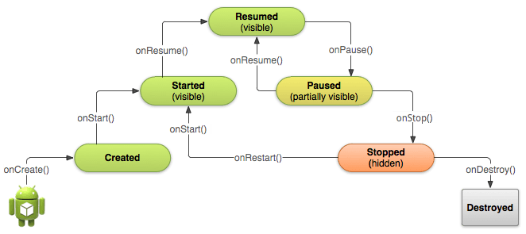
*Android Activity LifeCycle
Notes:
Store and sync data between users and devices in realtime using a cloud-hosted, NoSQL database. Updated data syncs across connected devices in milliseconds, and data remains available if your app goes offline, providing a great user experience regardless of network connectivity.

Slide 40
*Android Activity LifeCycle
어플리케이션이 처음 시작할 때 (Activity가 처음 만들어질 때) 호출되는 함수.
함수안에서는 주로 view를 만들며 이전 상태의 정보를 담고있는 Bundle을 제공
Notes:
Store and sync data between users and devices in realtime using a cloud-hosted, NoSQL database. Updated data syncs across connected devices in milliseconds, and data remains available if your app goes offline, providing a great user experience regardless of network connectivity.

Slide 41
*Android Activity LifeCycle
Activity가 다시 시작되기 전, 사용자에게 보여지기 직전에 호출되는 함수
Notes:
Store and sync data between users and devices in realtime using a cloud-hosted, NoSQL database. Updated data syncs across connected devices in milliseconds, and data remains available if your app goes offline, providing a great user experience regardless of network connectivity.

Slide 42
*Android Activity LifeCycle
Activity가 비로소 화면에 보여지는 단계
Notes:
Store and sync data between users and devices in realtime using a cloud-hosted, NoSQL database. Updated data syncs across connected devices in milliseconds, and data remains available if your app goes offline, providing a great user experience regardless of network connectivity.

Slide 43
*Android Activity LifeCycle
다른 Activity가 호출되기 전, 기존 Activity위에 다른 Activity가 올라왔지만 완전히 가려지지 않은 상태에서 호출되는 함수 (일부분이 보이거나 투명인 상태).
영구적인 데이터 저장은 이 함수에서 수행하는 것이 좋음.
다른 Activity가 호출되는 시간이 지연되므로 가급적 많은 작업은 하지 않는 것이 바람직함.
Notes:
Store and sync data between users and devices in realtime using a cloud-hosted, NoSQL database. Updated data syncs across connected devices in milliseconds, and data remains available if your app goes offline, providing a great user experience regardless of network connectivity.

Slide 44
*Android Activity LifeCycle
다른 Activity의 호출로 기존 Activity가 완전히 가려졌을 경우 (홈버튼을 누른 경우, 다른 Activity로 이동한 경우) 에 불리는 함수.
Notes:
Store and sync data between users and devices in realtime using a cloud-hosted, NoSQL database. Updated data syncs across connected devices in milliseconds, and data remains available if your app goes offline, providing a great user experience regardless of network connectivity.

Slide 45
*Android Activity LifeCycle
Activity가 멈췄다가 다시 호출될 때 불리는 함수
Notes:
Store and sync data between users and devices in realtime using a cloud-hosted, NoSQL database. Updated data syncs across connected devices in milliseconds, and data remains available if your app goes offline, providing a great user experience regardless of network connectivity.

Slide 46
*Android Activity LifeCycle
Activity가 완전히 없어질 때 호출되는 함수.
Notes:
Store and sync data between users and devices in realtime using a cloud-hosted, NoSQL database. Updated data syncs across connected devices in milliseconds, and data remains available if your app goes offline, providing a great user experience regardless of network connectivity.

Slide 47
Android Codelab 실습
14. Crash 보고하기
app/build.gradle에 Firebase Crashlytics dependency가 있는지 확인. 없으면 추가
apply plugin: 'com.android.application’
apply plugin: 'io.fabric’
dependencies {
// ...
implementation 'com.crashlytics.sdk.android:crashlytics:2.7.1’
}
Notes:
Store and sync data between users and devices in realtime using a cloud-hosted, NoSQL database. Updated data syncs across connected devices in milliseconds, and data remains available if your app goes offline, providing a great user experience regardless of network connectivity.

Slide 48
Android Codelab 실습
14. Crash 보고하기
project/build.gradle에 Firebase Crashlytics dependency가 있는지 확인. 없으면 추가
buildscript {
repositories {
// ...
maven {
url 'https://maven.fabric.io/public’
}
}
dependencies {
// ...
classpath 'io.fabric.tools:gradle:1.24.4’
}
}
Notes:
Store and sync data between users and devices in realtime using a cloud-hosted, NoSQL database. Updated data syncs across connected devices in milliseconds, and data remains available if your app goes offline, providing a great user experience regardless of network connectivity.

Slide 49
Android Codelab 실습
14. Crash 보고하기
MainActivity.java의 onOptionsItemSelected()에 아래 큰 글씨 코드를 추가
@Override public boolean onOptionsItemSelected(MenuItem item) {
switch (item.getItemId()) {
case R.id.crash_menu:
Log.w("Crashlytics", "Crash button clicked");
causeCrash();
return true;
case …
}
}
Notes:
Store and sync data between users and devices in realtime using a cloud-hosted, NoSQL database. Updated data syncs across connected devices in milliseconds, and data remains available if your app goes offline, providing a great user experience regardless of network connectivity.

Slide 50
Android Codelab 실습
14. Crash 보고하기
MainActivity.java에 causeCrash()를 추가
private void causeCrash() {
throw new NullPointerException("Fake null pointer exception");
}
Notes:
Store and sync data between users and devices in realtime using a cloud-hosted, NoSQL database. Updated data syncs across connected devices in milliseconds, and data remains available if your app goes offline, providing a great user experience regardless of network connectivity.

Slide 51
Android Codelab 실습
14. Crash 보고하기
테스트하기
Firebase 콘솔의 왼쪽 메뉴의 Quality로 가서 ‘Crashlytics’를 클릭
‘Set up Crashlytics’ 버튼 클릭
‘This app is new to Crashlytics.’ 선택
앱 실행
오른쪽 상단 메뉴에서 CauseCrash를 선택
Logcat를 확인하여 crash가 성공적으로 보고되었는지 확인
Firebase 콘솔에서도 확인가능
Notes:
Store and sync data between users and devices in realtime using a cloud-hosted, NoSQL database. Updated data syncs across connected devices in milliseconds, and data remains available if your app goes offline, providing a great user experience regardless of network connectivity.

Slide 52
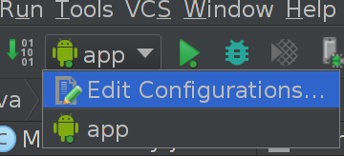
Android Codelab 실습
15. 앱 테스트하기
MainActivityEspressoTest.java에 테스트케이스 추가
테스트를 위해 새로운 run configuration 만들기
@Test public void verifySignUpButtonDisplayed() { onView(ViewMatchers.withId(R.id.sign_in_button)).check(matches(isDisplayed()));
}
Notes:
Store and sync data between users and devices in realtime using a cloud-hosted, NoSQL database. Updated data syncs across connected devices in milliseconds, and data remains available if your app goes offline, providing a great user experience regardless of network connectivity.

Slide 53
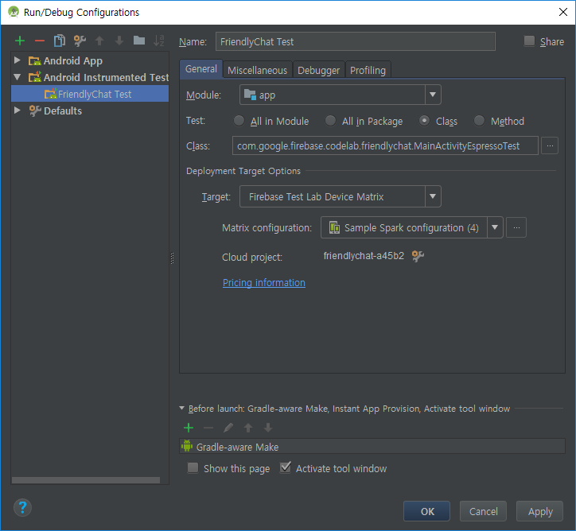
Android Codelab 실습
15. 앱 테스트하기
‘+’ 버튼 누르고 ‘Android Instrumented Tests’ 선택
아래와 같이 입력
Name: FriendlyChat Test
Module: app
Test: Class
Class: com.google.firebase.codelab.friendlychat.MainActivityEspressoTest
Target: Firebase Test Lab Device Matrix
Connect to Google Cloud Platform
Notes:
Store and sync data between users and devices in realtime using a cloud-hosted, NoSQL database. Updated data syncs across connected devices in milliseconds, and data remains available if your app goes offline, providing a great user experience regardless of network connectivity.

Slide 54
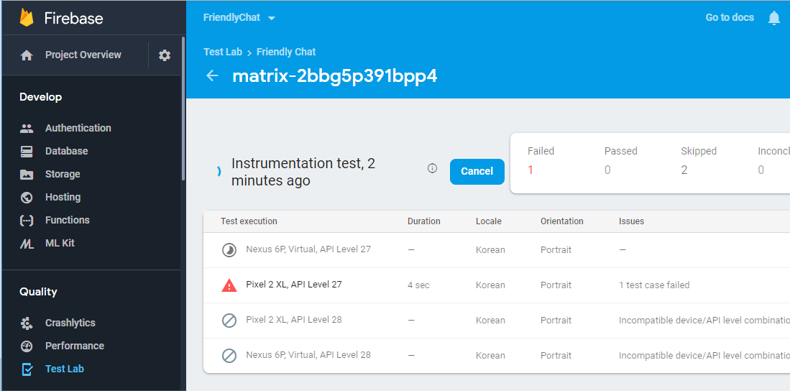
Android Codelab 실습
15. 앱 테스트하기
4. 앱 실행하기
Rule은 주석처리
5. Firebase 콘솔의 Quality에서 Test Lab 클릭 후 결과 확인
Notes:
Store and sync data between users and devices in realtime using a cloud-hosted, NoSQL database. Updated data syncs across connected devices in milliseconds, and data remains available if your app goes offline, providing a great user experience regardless of network connectivity.

